Slide 1
Responses of animals to the biotic environment
Interspecific aggressive responses
Defence strategies against predators 2: Mimics

Slide 2
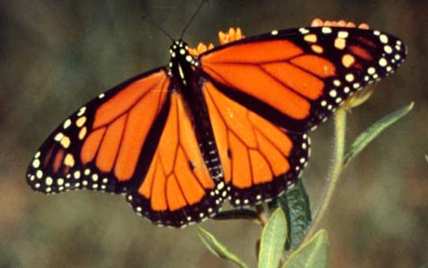
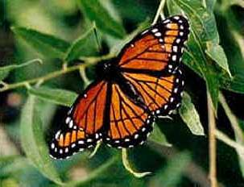
Batesian Mimicry
A harmless species resembles a dangerous or harmful one.
Monarch –poisonous
Viceroy - harmless

Slide 3
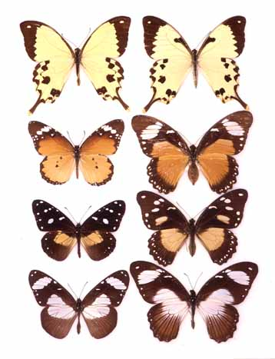
Batesian Mimicry is widespread among tropical butterflies
At top left is the Papilio dardanus male;
at top right is a non-mimetic, male-like female of the same species.
On the left bottom three rows, unpalatable butterfly model species in the family Danaidae
On the bottom right three rows, palatable mimetic forms of female Papilio dardanus, an African swallowtail species.

Slide 4
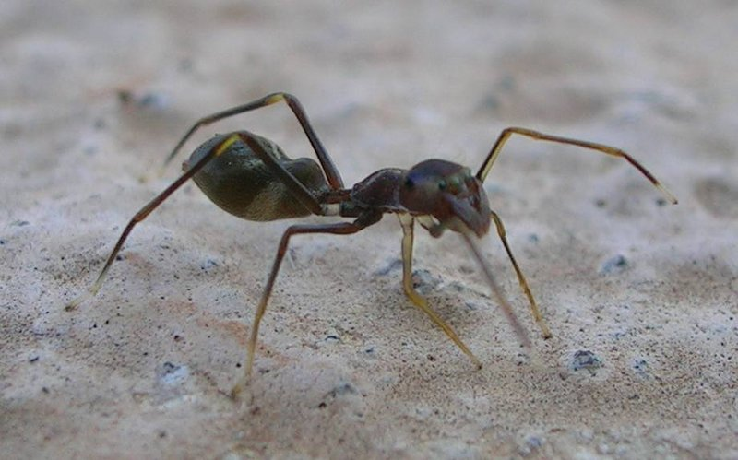
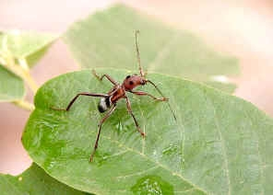
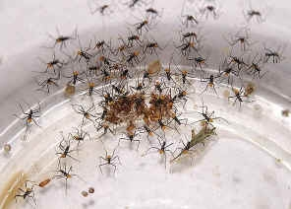
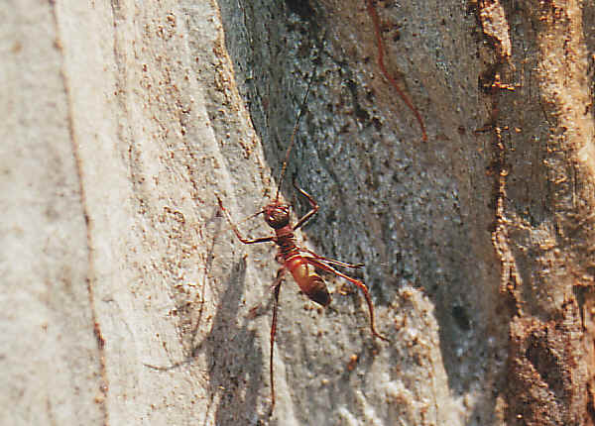
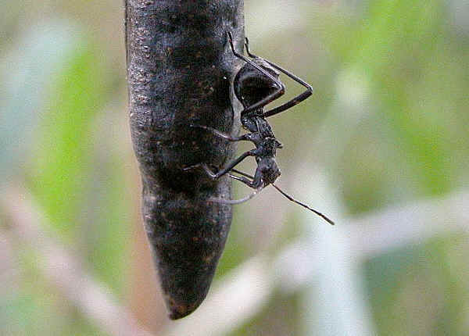
These are all ant mimics
Spider
Beetle
Assassin bugs
Katydid
Podsucker bug

Slide 5
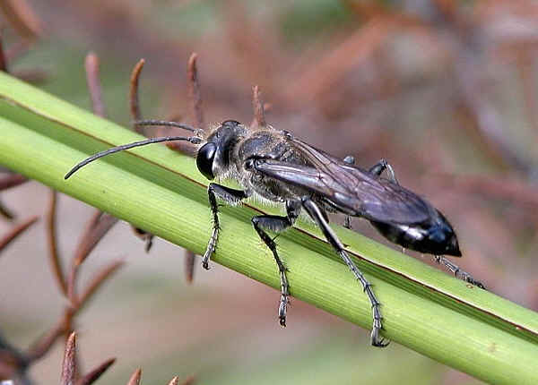
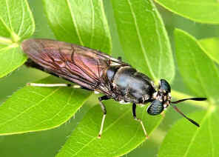
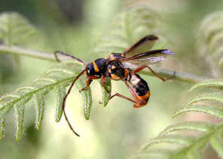
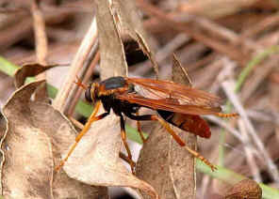
Wasp mimics
A real digger wasp
Soldier fly
Beetle
Robber fly

Slide 6
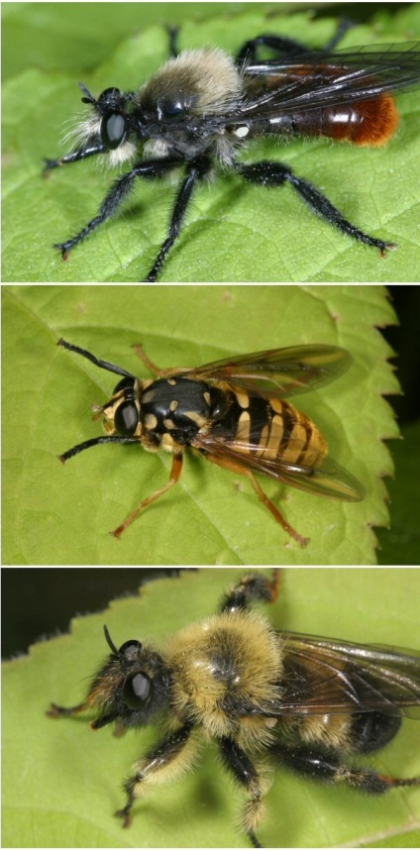
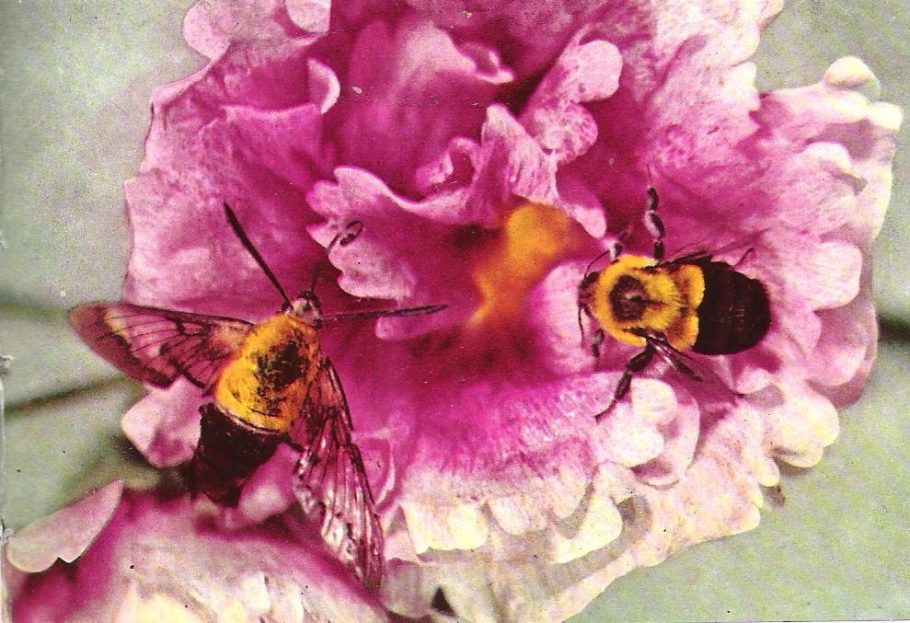
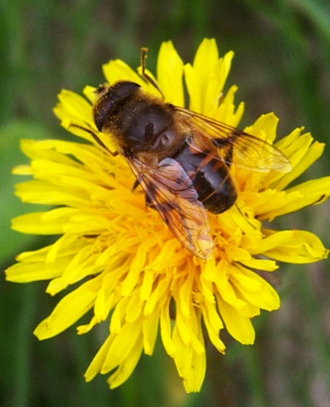
Bee mimics
A real bee
A moth
A dronefly
All flies

Slide 7
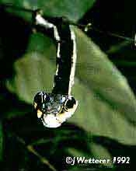
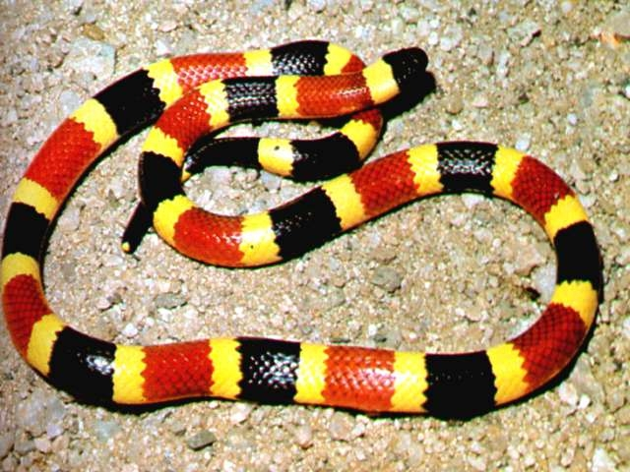
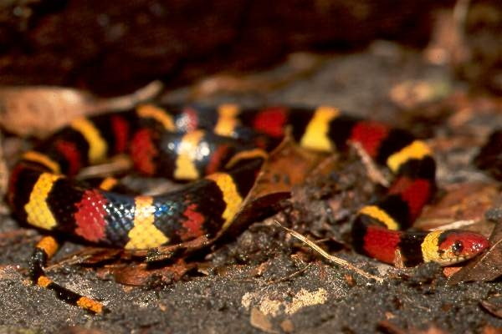
Snakes
Poison coral snake
Caterpillar
Harmless king snake

Slide 8
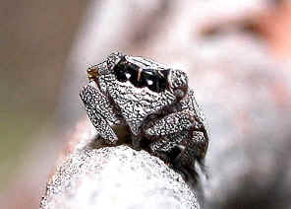
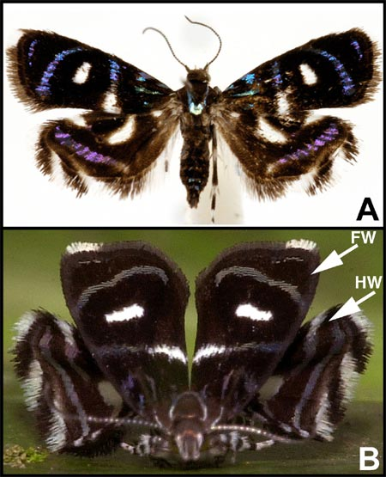
Spider mimics
A bug looking like a jumping spider
A tricky moth
Now I’m a moth
Now I’m a spider

Slide 9
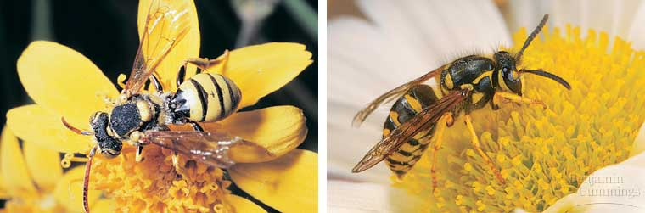
Mullerian mimicry
Poisonous species have the same colouration
Many wasp and bee species wear Taranaki colours

Slide 10
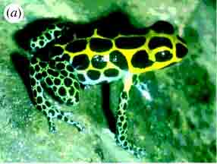
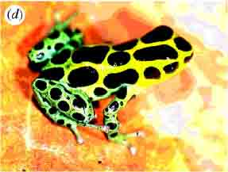
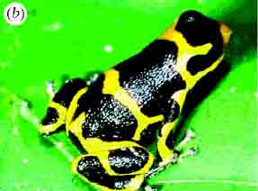
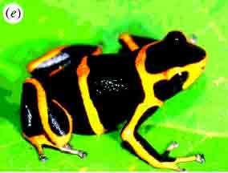
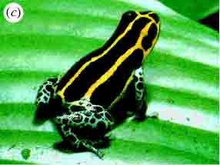
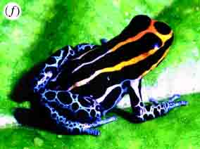
Müllerian mimicry in Dendrobates frogs in Peru
The three frogs a - c are all supposedly members of a single species, Dendrobates imitator. Each of these different morphs is sympatric with a different species in a different geographical region. The species with which each morph is sympatric is shown beside that morph.
The species are:
d. Dendrobates variabilis (Tarapoto),
e. Dendrobates fantasticus (Huallaga Canyon) and
f.`Dendrobates ventrimaculatus’ (Yurimaguas).

Slide 11
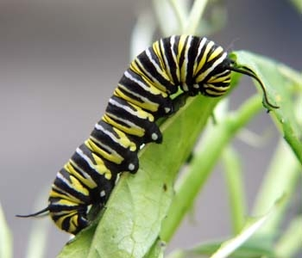
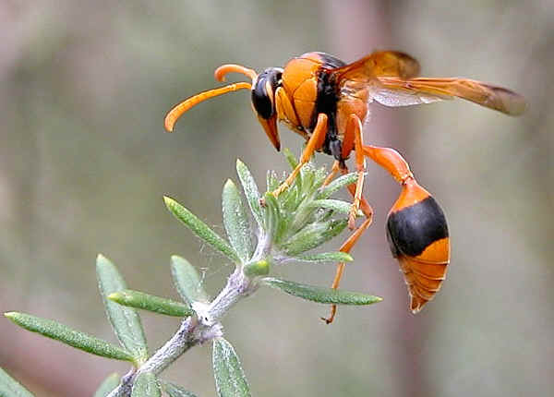
Aposematic (warning) Colouration
Many dangerous, harmful, poisonous or distasteful animals are often brightly coloured and striped. A predator that has been stung, bitten or harmed by one species will usually leave similarly coloured animals alone.
Monarch caterpillar
A potter wasp

Slide 12
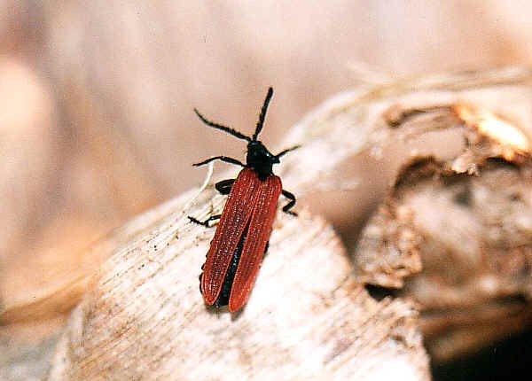
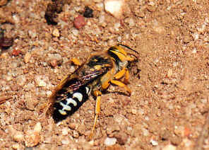
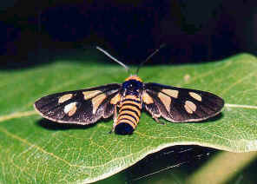
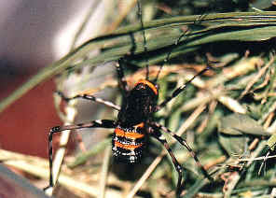
More aposematic examples

Slide 13
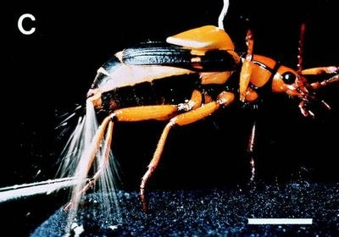
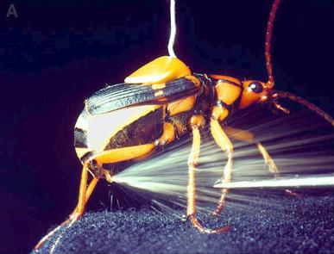

Firing Chemicals
The bombardier beetle can fire a hot, toxic spray in any direction.

Slide 14
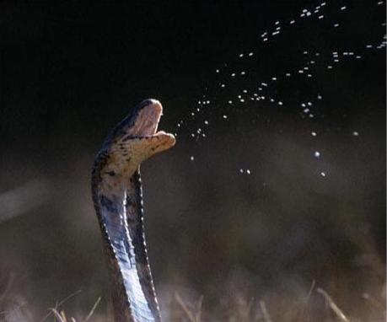
Say it don’t spray it!
Beware - Don’t be where the cobra spits

Slide 15
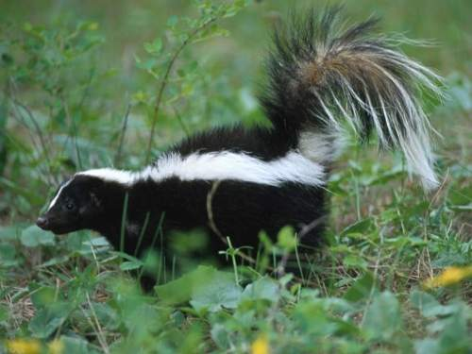
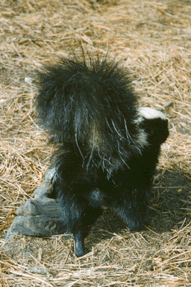
Just leave me alone – O.K.!!
What a cute little animal!
But if it stamps and points its rear end at you – get out of there!!

Slide 16
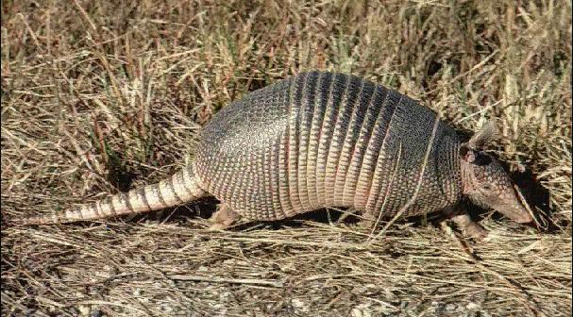
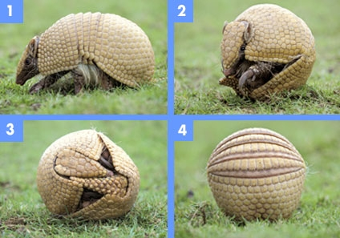
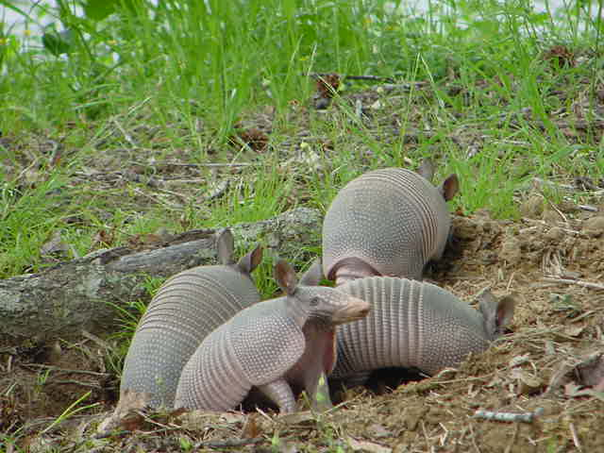
Some animals just curl up
Armadillos are experts at this!

Slide 17
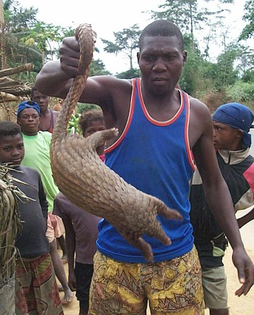
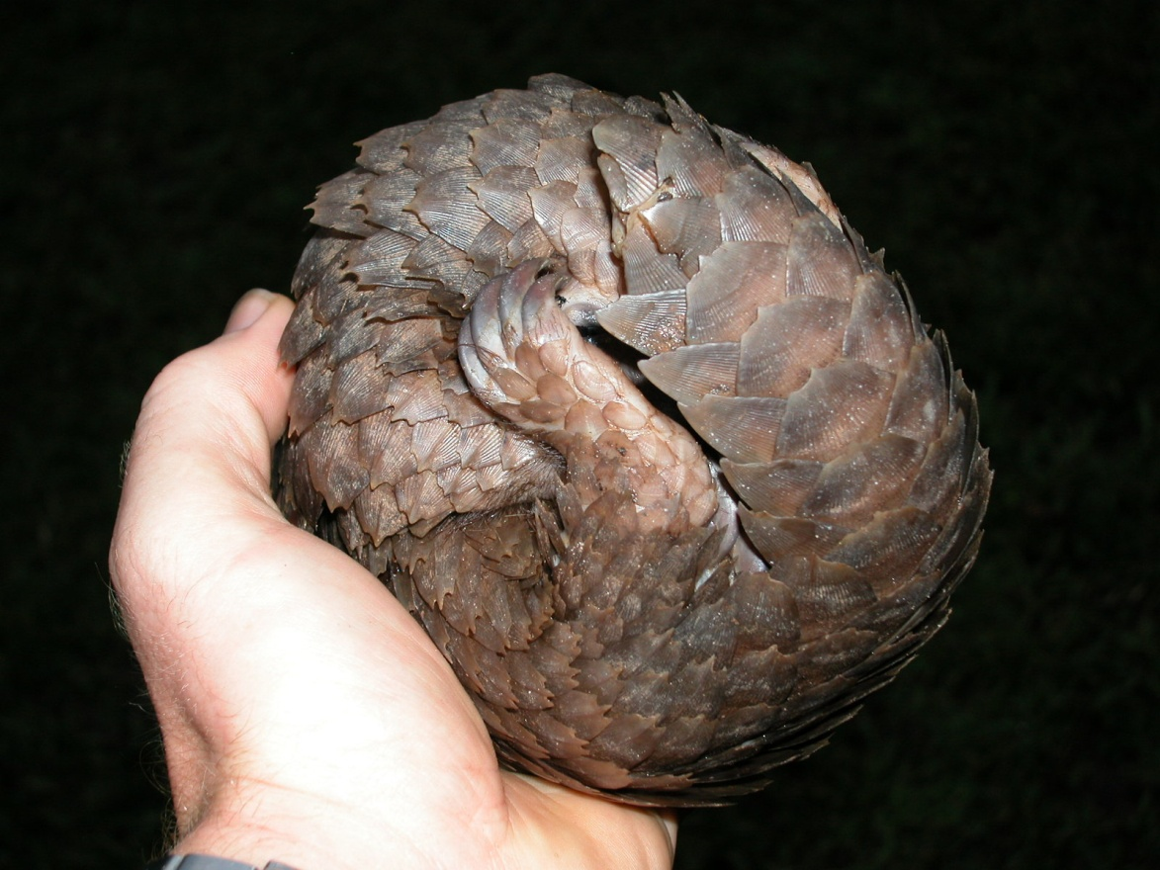
The pangolin is also good at curling up

Slide 18
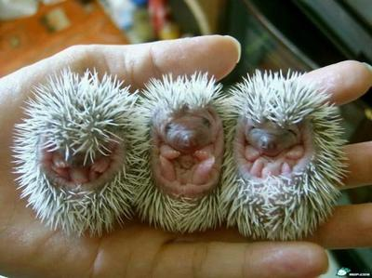
And then there’s hedgehogs

Slide 19
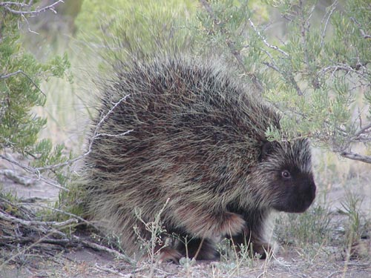
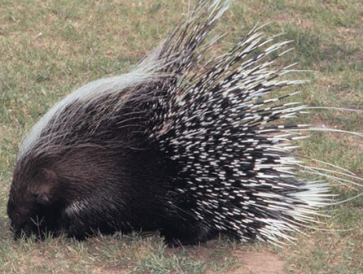
Speaking of using spines for defence, here are an American porcupine (left) and, African porcupine (right).
Ok, they don’t curl up, but they don’t usually get eaten either.

Slide 20
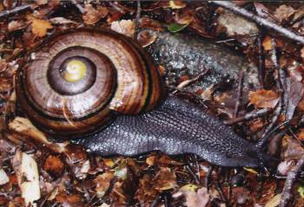
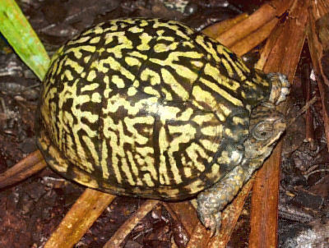
If not spines, what about a shell?
A native N.Z. snail – about 5 cm across
A box turtle

Slide 21
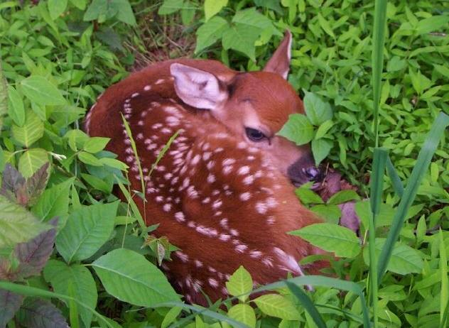
Hiding
This fawn would be hard for a predator to spot. It freezes and its spots look like dappled sunlight on leaves

Slide 22
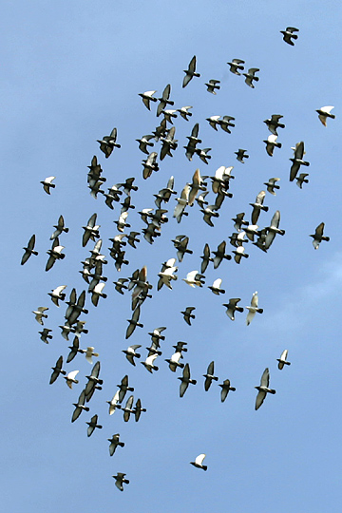

Being part of a large group can be a useful way to escape individual attention from a predator.
Birds do it
Starlings (lots of them!)
pigeons

Slide 23

Fish often swim in schools, e.g. snapper

Slide 24

Musk oxen form a defensive circle against wolves

Slide 25



Keeping Watch
Animals like meerkats and baboons always have at least one member on lookout duty.

Slide 26


And then you can just play dead and hope that the predator only likes live meat
Its known as “playing possum”
Hey Rover, do you think he’s really, like, you know – dead?

Slide 27


This spider is trying to win an Oscar.
Even this bat thought he would give it a try.

Slide 28



Even more “dead” animals
Some snakes will also act dead
Lizards too
And this armadillo
– wait up… he’s really dead. Another road statistic

